Slide 1
SOFTWARE ENGINEERING AND PROJECT MANAGEMENT
-MAYANK SINHA(RA1911003010386)
SHIVAM PANDEY(RA1911003010383)
ABHIJEET PADHI(RA1911003010393)

Slide 2
PROBLEM STATEMENT
AS THE NAME SAYS PEDESTRIAN AND VEHICLE DETECTOR DETECTS PEOPLE AND OTHER VEHICLES BEFOREHAND AND GIVES YOU THE INDICATIONS. THIS SOFTWARE WORKS EXTREMELY WELL WITH AUTOMATIC EMERGENCY BRAKING SYSTEM WHICH IS DESIGNED TO AUTOMATICALLY ENGAGE THE BRAKES TO REDUCE THE IMPACT OF AN UNAVOIDABLE FRONTAL COLLISION. AS WE TURN ON THE VEHICLE IT COMES INTO POWER AND IT SCANS THE ENVIROMENT, MARKING THE PEDESTRIANS IN GREEN AND OTHER VECHILES IN RED, AND SHOWS IT ON THE SCREEN. THIS SOFTWARE WORKS AS A DRIVER ASSISTANCE SYSTEMS AIMING TO ALERT DRIVERS ABOUT DRIVING ENVIRONMENTS AND POSSIBLE COLLISION WITH OTHER VEHICLE OR PEOPLE. THIS SOFTWARE ACTUALY REPLACES A MAGNETOMETER WHICH WORKS BY USING PASSIVE SENSING TECHNOLOGY TO DETECT LARGE FERROUNS OBJECTS BY MEASURING MAGNETIC FIELD. BUT IT WAS NOT VERY ACCURATE SO THIS METHOD BECOMES A BIT DANGEROUS AT HIGH SPEED.

Slide 3
THIS SOFTWARE WORKS IN FOLLOWING STEPS:
FIRST IT CHECKS FOR THE CAMERA TO RUN UNTIL WE COMMAND IT TO STOP.
IT CAPTURES THE LIVE COLOURED RUNNING IMAGES AND TURN IT INTO BLACK AND WHITE FOR EASY DETECTION.
THIS SOFTWARE USES THE PRETRAINED HAAR CASCADE (it is a machine learning based approach where a cascade function is trained from a lot of positive and negative images.it is then used to detect objects in other images) MODEL FOR THE DETECTION.
WE GET ALL THE COORDINATES, HIGHT AND WIDTH OF THE REGION OF THE VEHICLES AND THE PEDESTRIANS.
THEN IT SHOW THE VIDEO WITH RECTANGLE BOXES AROUND THE DETECTED VEHICLES AND PEDESTRIANS SIGNNALING DANGER IF ANY.
THE SOFTWARE KEEPS THE VIDEO FEED ON UNTIL WE COMMAND IT TO SHUT DOWN.
IT IS MUCH BETTER THAN THE LAST TECH.BECAUSE IT DOES NOT DEPEND ON THE MAGNETIC FIELDS AND RATHER WORKS DIRECTLY ON THE IMAGE PROCESSED.

Slide 4
WHAT IS HAAR CASCADE?
Object Detection using Haar feature-based cascade classifiers is an effective method proposed by Paul Viola and Michael Jones in the 2001 paper, "Rapid Object Detection using a Boosted Cascade of Simple Features". It is a machine learning based approach in which a cascade function is trained from a lot of positive and negative images. It is then used to detect objects in other images.
Here we will work with face detection. Initially, the algorithm needs a lot of positive images (images of faces) and negative images (images without faces) to train the classifier. Then we need to extract features from it. For this, Haar features shown in below image are used. They are just like our convolutional kernel. Each feature is a single value obtained by subtracting the sum of pixels under the white rectangle from the sum of pixels under the black rectangle

Slide 5


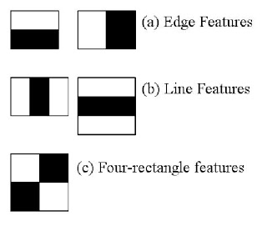
Now all possible sizes and locations of each kernel are used to calculate plenty of features. For each feature calculation, we need to find the sum of the pixels under the white and black rectangles. To solve this, they introduced the integral images. It simplifies calculation of the sum of the pixels, how large may be the number of pixels, to an operation involving just four pixels.
But among all these features we calculated, most of them are irrelevant. For example, consider the image below. Top row shows two good features. The first feature selected seems to focus on the property that the region of the eyes is often darker than the region of the nose and cheeks. The second feature selected relies on the property that the eyes are darker than the bridge of the nose. But the same windows applying on cheeks, or any other place is irrelevant. So how do we select the best features out of 160000+ features? It is achieved by Ad boost

Slide 6
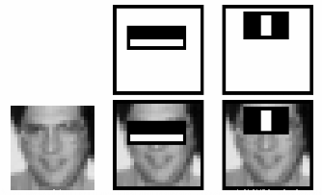
For this, we apply each feature on all the training images. For each feature, it finds the best threshold which will classify the faces to positive and negative. But obviously, there will be errors or misclassifications. We select the features with minimum error rate, which means they are the features that best classifies the face and non-face images. (The process is not as simple as this. Each image is given an equal weight in the beginning. After each classification, weights of misclassified images are increased. Then again same process is done. New error rates are calculated. Also new weights. The process is continued until required accuracy or error rate is achieved or required number of features are found).
Final classifier is a weighted sum of these weak classifiers. It is called weak because it alone can't classify the image, but together with others forms a strong classifier. The paper says even 200 features provide detection with 95% accuracy. Their final setup had around 6000 features. (Imagine a reduction from 160000+ features to 6000 features. That is a big gain).

Slide 7

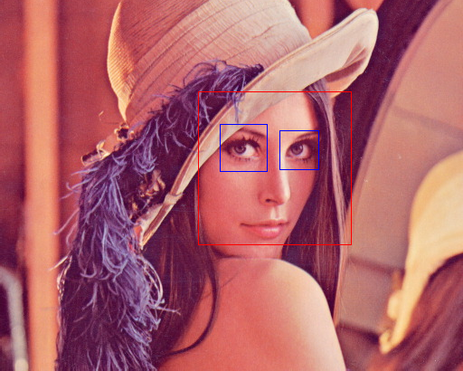
So now you take an image. Take each 24x24 window. Apply 6000 features to it. Check if it is face or not. Wow.. Wow.. Isn't it a little inefficient and time consuming? Yes, it is. Authors have a good solution for that.
In an image, most of the image region is non-face region. So, it is a better idea to have a simple method to check if a window is not a face region. If it is not, discard it in a single shot. Don't process it again. Instead focus on region where there can be a face. This way, we can find more time to check a possible face region.
For this they introduced the concept of Cascade of Classifiers. Instead of applying all the 6000 features on a window, group the features into different stages of classifiers and apply one-by-one. (Normally first few stages will contain very a smaller number of features). If a window fails the first stage, discard it. We don't consider remaining features on it. If it passes, apply the second stage of features and continue the process. The window which passes all stages is a face region. How is the plan !!!Authors' detector had 6000+ features with 38 stages with 1, 10, 25, 25 and 50 features in first five stages. (Two features in the above image is actually obtained as the best two features from Ad boost). According to authors, on an average, 10 features out of 6000+ are evaluated per sub-window.

Slide 8
REQUIREMENTS
REAL TIME VIDEO CAPTURE
FRAME EXTRACTION
IMAGE ACQUISITION
IMAGE SEGMENTATION
IMAGE RECOGNITION
OBJECT RECOGNITION
OBJECT EXTRACTION
HIGH RESOLUTION IMAGE CAPTURE
EXECUTION SPEED
ACCURACY/SECURITY/PORTABLITIY/DURABILITY.

Slide 9
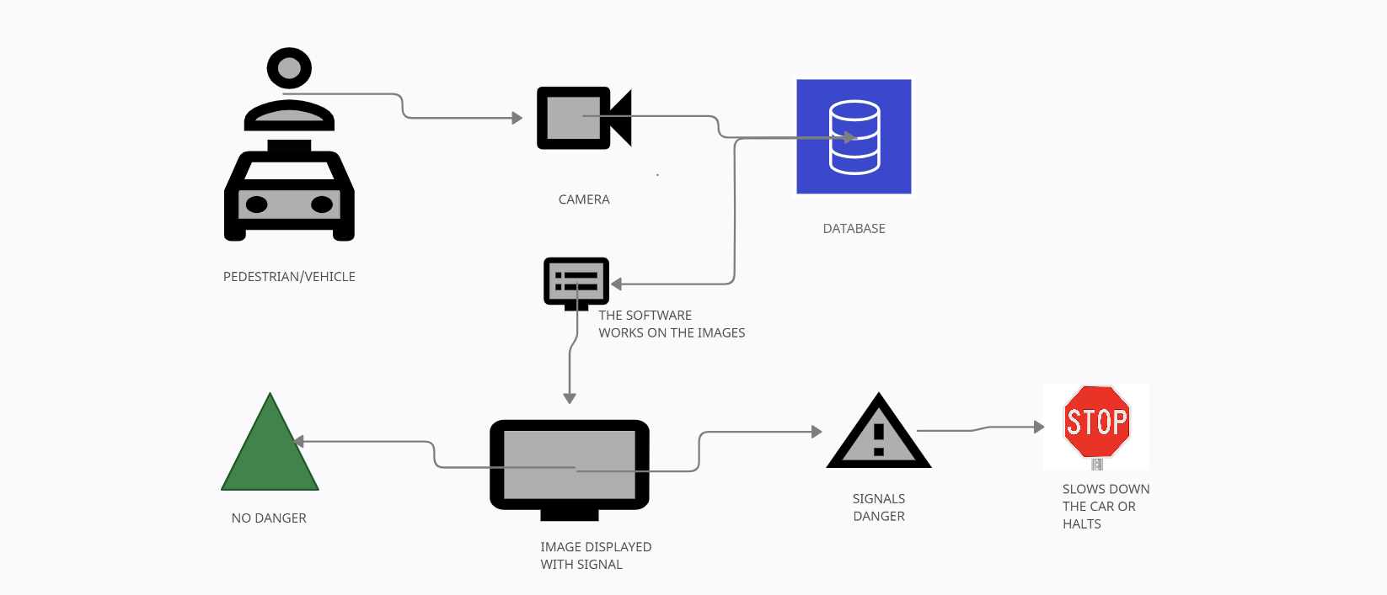
ARCHITECTURE DIAGRAM

Slide 10
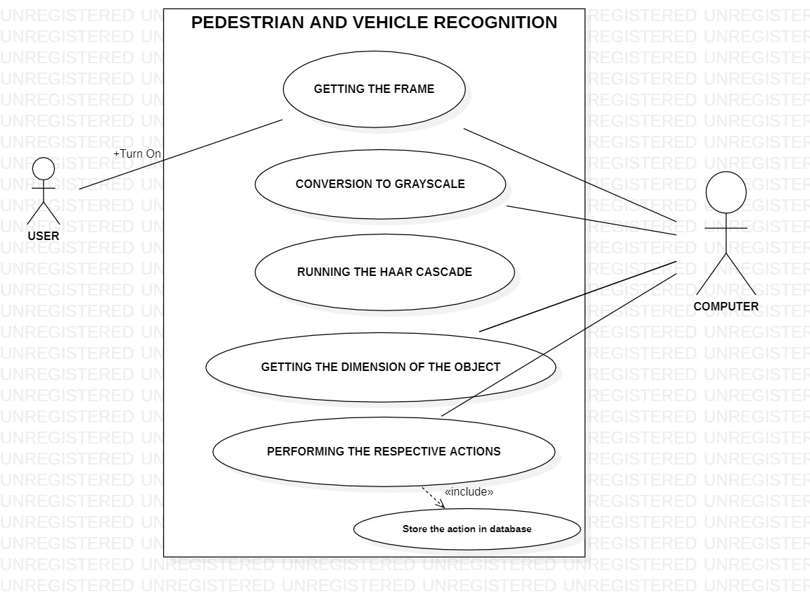
USE CASE DIAGRAM

Slide 11
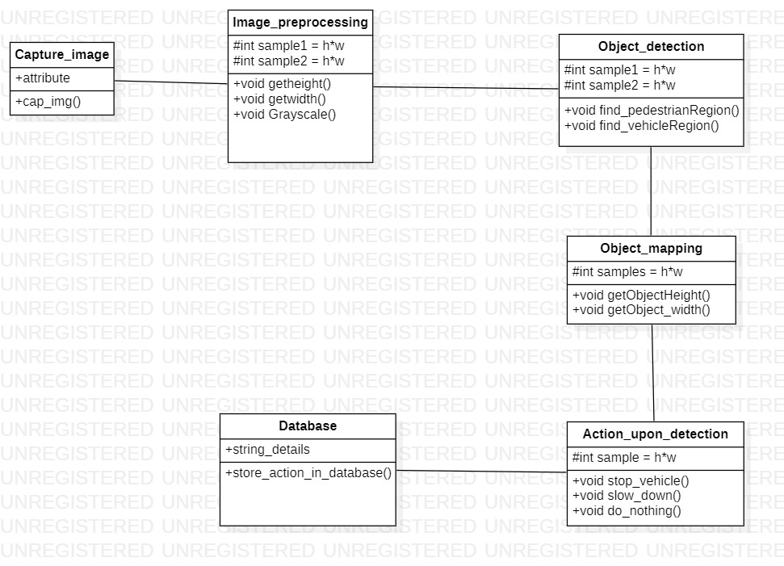
CLASS DAIGRAM

Slide 12
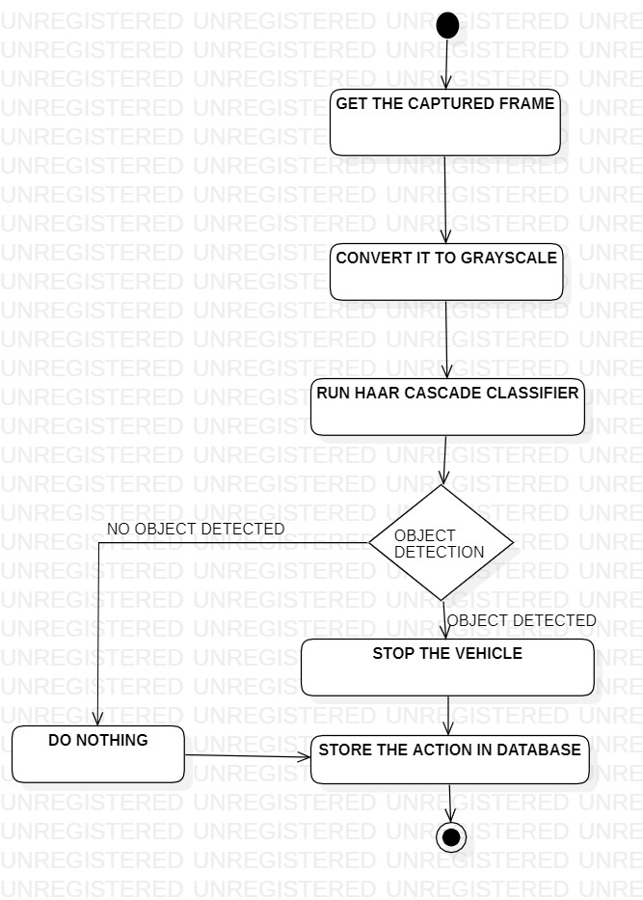
ACTIVITY DIAGRAM

Slide 13
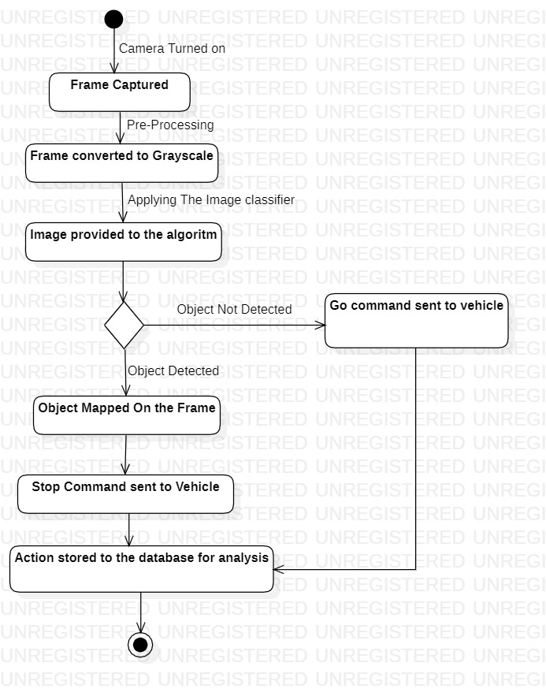
STATE DIAGRAM

Slide 14
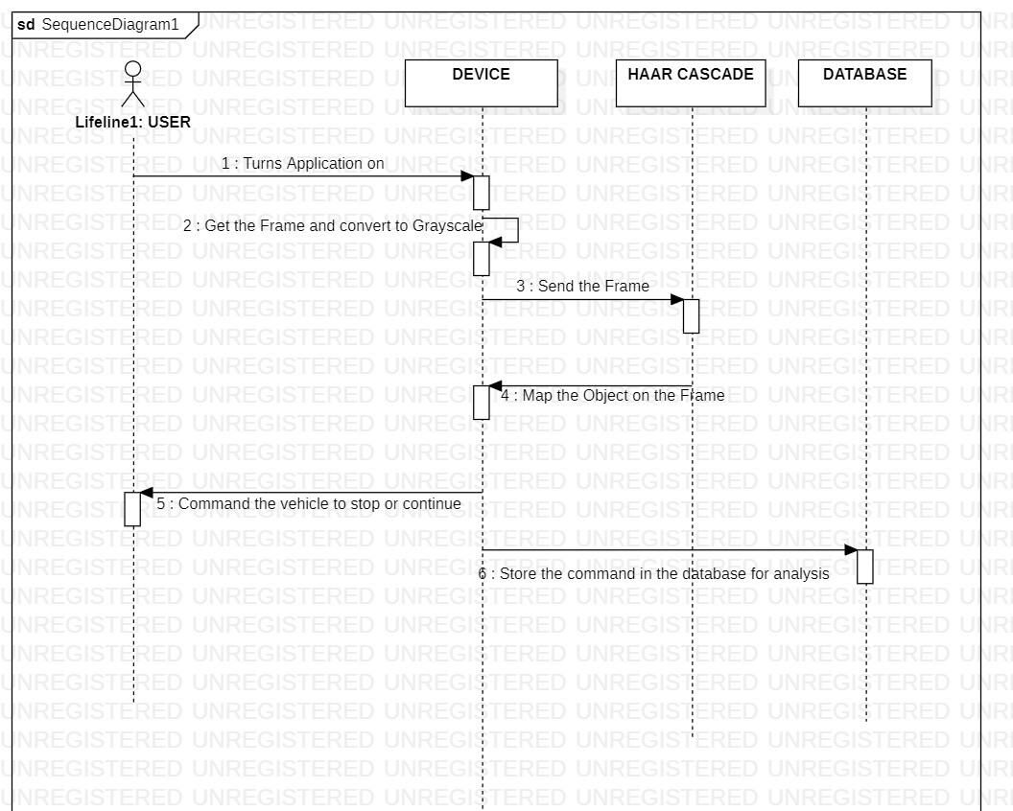
SEQUENCE DAIGRAM

Slide 15
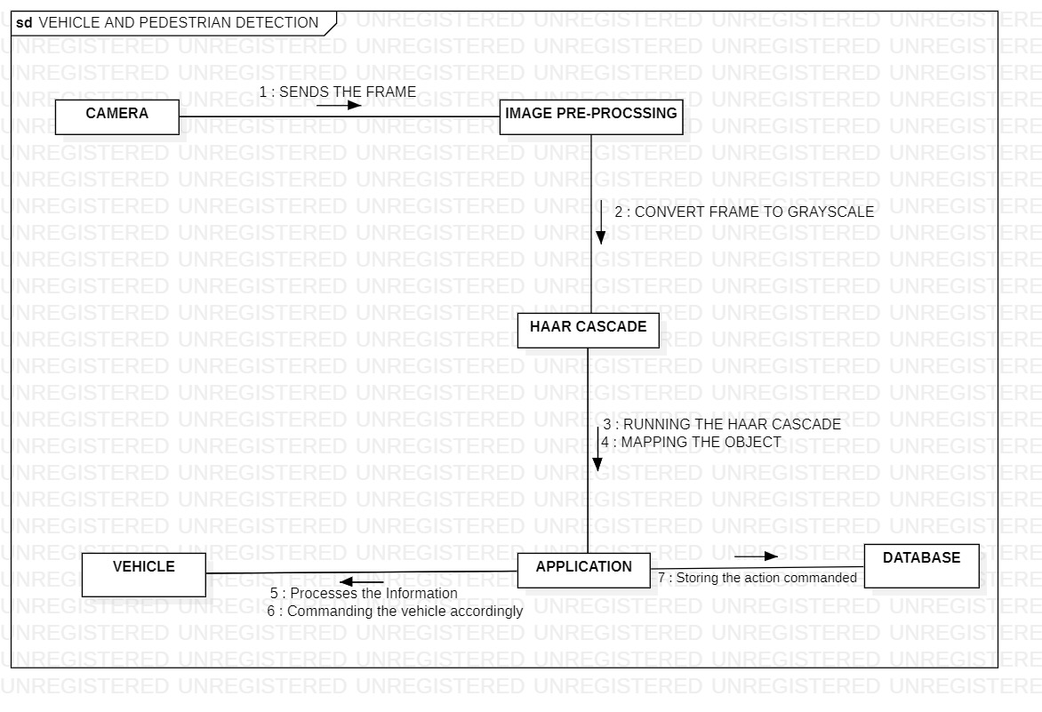
COLLABORATION DIAGRAM

Slide 16
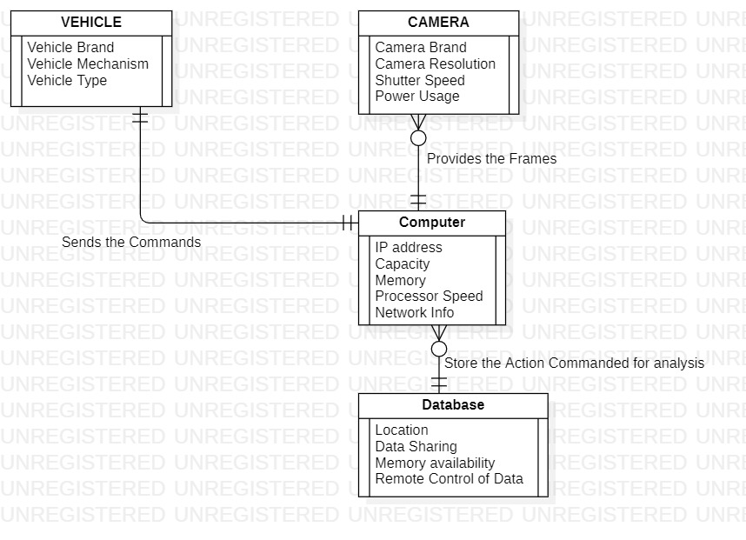
ER DIAGRAM

Slide 17
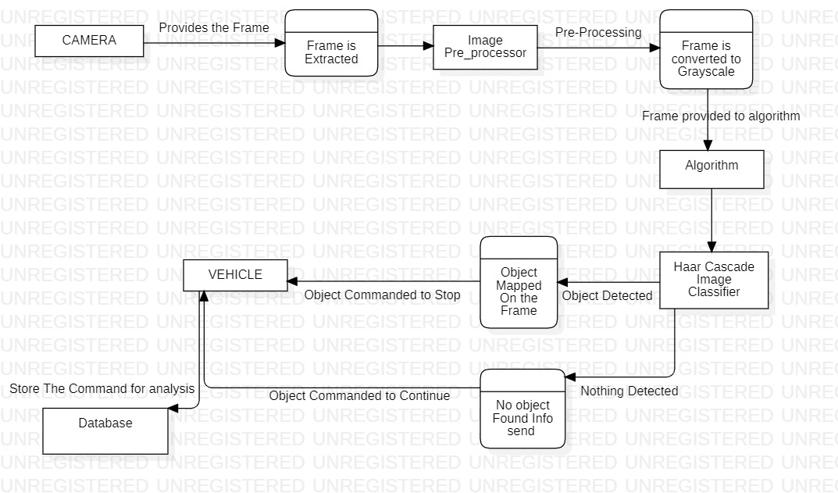
DFD DIAGRAM

Slide 18
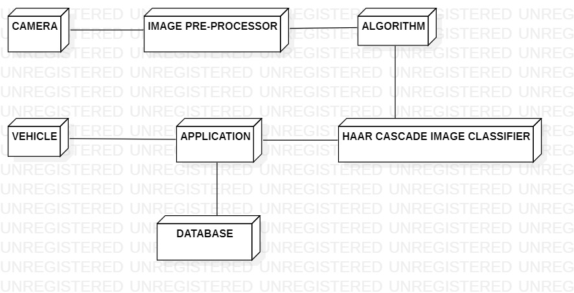
DEPLOYMENT DAIGRAM

Slide 19
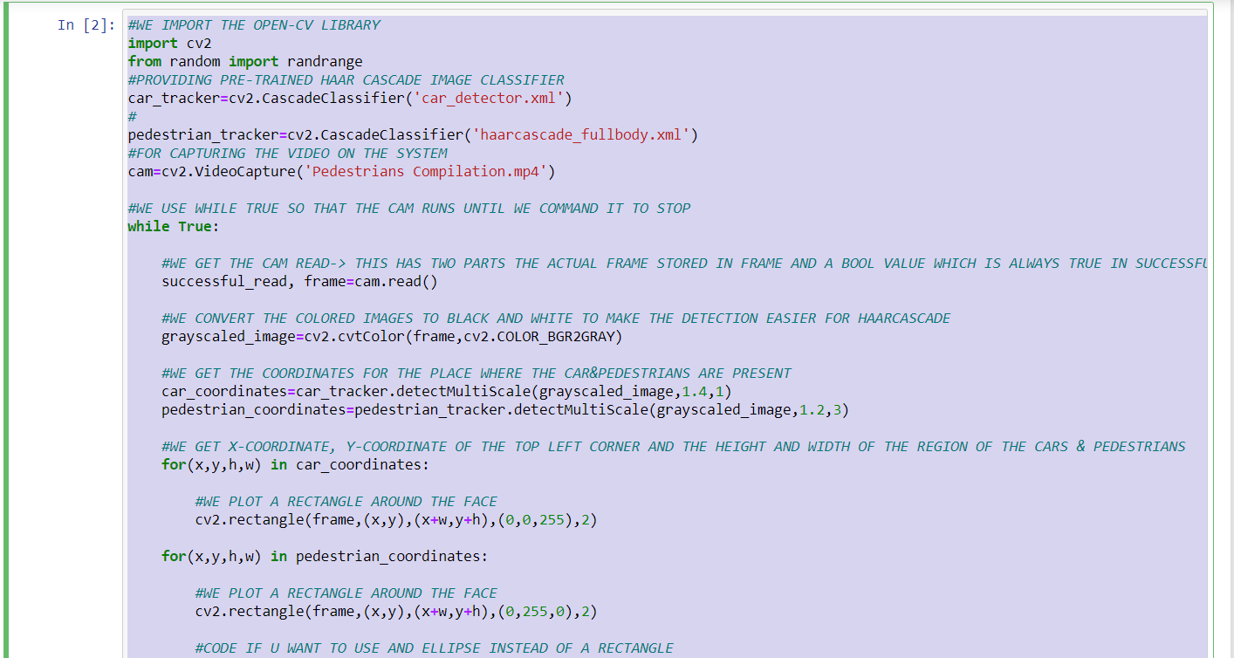
CODE

Slide 20
TEST CASES

Slide 21
ID | TEST CASES | TEST DATA | EXPECTED RESULT | ACTUAL RESULT | STATUS
1 | Test if the vehicle is off. | Trial of the software. | Vehicle must be turned on. | System working. | Test successful
2 | Test if the vehicle is on. | Trial of the software | Vehicle must be turned on. | System working. | Test successful
3 | Check of the software detects in crowded places. | Trial of the software in crowded places | Detects the object | System failed | test failed
4 | Check if the software detects fast moving objects. | Trial of the software. | Should detect the object. | System pass. | Test successful
5 | Check if the software work properly in fog or rain | Trial if the software | Should detect the object | System failed. | Test failed
6 | Check if the software detects in broad sunlight | trial of the software in sunlight | detects the pedestrians clearly | detects the pedestrians clearly | test successful
7 | Check if the software detects in dim lighting | trial of the software in dim lighting | detects the pedestrians clearly | detects the pedestrians with some difficulty | test successful
8 | Check if the software detects pedestrians while the car is moving at slow speed (10-40 km/h) | trial of the software in a vehicle moving at the mentioned speed | detects the pedestrians clearly | detects the pedestrians clearly | test successful
9 | Check if the software detects pedestrians while the car is moving at medium speed (50-90 km/h) | trial of the software in a vehicle moving at the mentioned speed | detects the pedestrians clearly | detects the pedestrians clearly | test successful
10 | Check if the software detects pedestrians while the car is moving at high speed (100 km/h and above) | trial of the software in a vehicle moving at the mentioned speed | detects the pedestrians clearly | detects the pedestrians with some difficulty | test successful
11 | Check if the software stops the vehicle when pedestrian is detected | if the software automatically stops the vehicle | vehicle is stopped | vehicle is stopped | test successful
12 | Check if the payment portal is working | payment is received or declined | payment received | payment received | test successful

